Slide 1
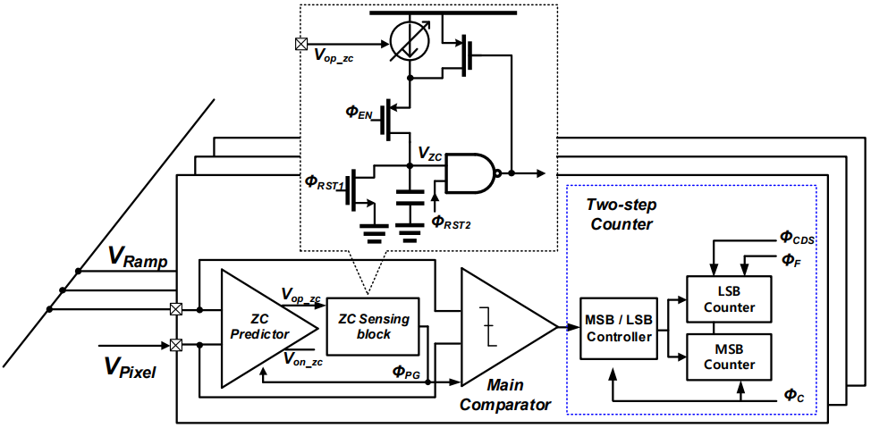
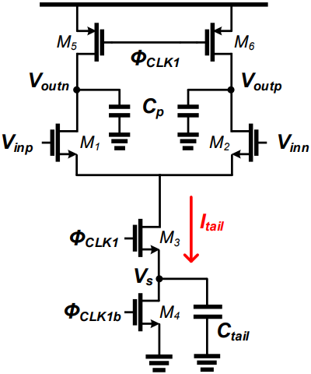
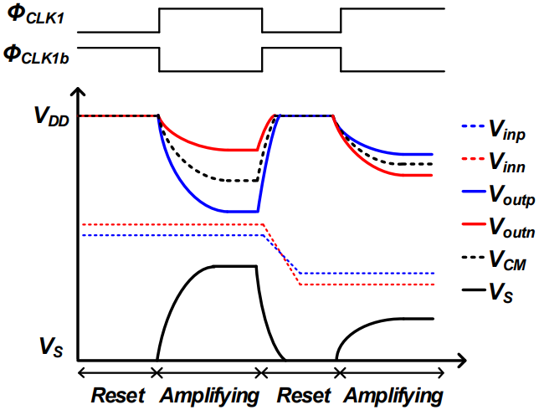
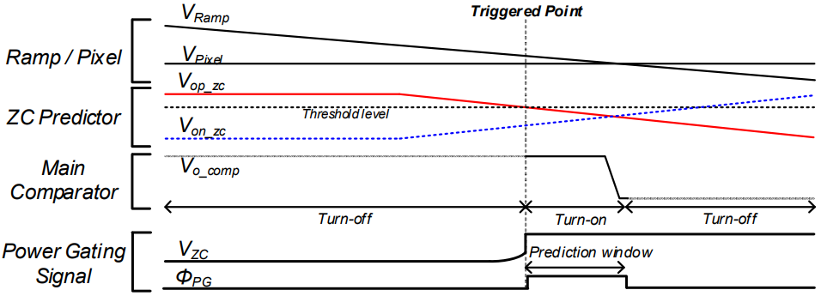
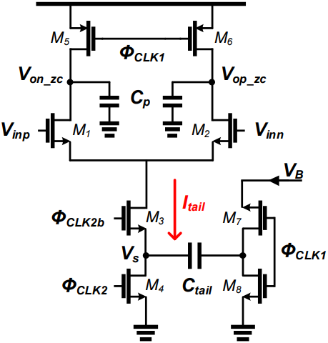
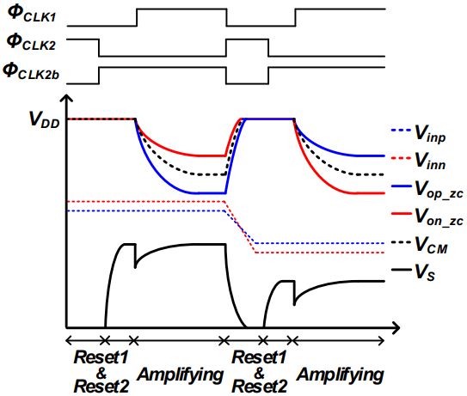
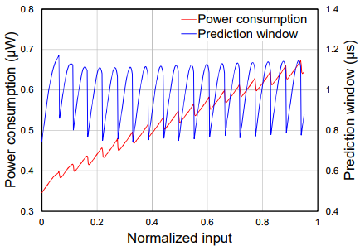
Zero-crossing-prediction-based Single-slope ADC
with a Constant Charge Bias Amplifier for Low Power
Hohyeon Lee, Kyungmin Lee, Sooyoun Kim and Minkyu Song
Department of Semiconductor Science, Dongguk University, Seoul, 04620, Korea
Email : kj170494@dongguk.edu, {dlghgus020, sooyoun}@dgu.ac.kr
Introduction
As image sensors have been used in various mobile applications, the demand for low-power operations has been increasing because of the limited battery life. The static power consumption in the comparator and the increase in the toggling number according to the bit depth of the counter degrade the SS-ADC energy efficiency. For low-power readout circuits without additional power consumption this paper presents a comparator power-gating technique with a gain-difference-based ZC prediction in SS-ADC.
(a)
(a)
(b)
Fig. 1. Proposed SS-ADC. (a) Overall architecture, (b) proposed zero-crossing prediction algorithm.
(b)
The SS-ADC comprises low gain response of the ZC predictor, High gain response of the main comparator (M-CMP), ZC-sensing block and counter.
Fig. 2. (a) Schematic and timing diagram of the conventional dynamic bias amplifier. (b) Schematic and timing diagram of the proposed constant charge bias amplifier schematic and timing diagram.
Fig. 3. Input level dependent output response variation: (a) gain, (b) output common mode level.
Fig. 4. Analog block power consumption and prediction window size.
Conclusion
The gain- difference-based ZC prediction algorithm was implemented with an energy-efficient CQBA without additional ramp signals. The proposed CQBA improved the ICMR characteristics of dynamic pre-amplifiers with an input-independent gain variation. Additionally, the simulation results showed that constant power gating can reduce 80% of the M-CMP power consumption. The proposed SS-ADC was designed for a 110-nm CMOS image sensor process and achieved 51.5 pJ/pixel of a figure of merit, which is 20% lower than previous studies.
The chip fabrication and EDA tool were supported by the IC Design Education Center(IDEC), Korea.
[1] H. S. Bindra, C. E. Lokin, D. Schinkel, A.-J. Annema, and B. Nauta, “A 1.2-V dynamic bias latch-type comparator in 65-nm CMOS with 0.4-mV input noise,” IEEE J. Solid-State Circuits, vol. 53, no. 7, pp. 1902–1912, Jul. 2018.

